Slide 1
Onion Routing
By
Name: Khan Umaid
Roll No: 18039

Slide 2
Introduction
The Onion routing(Tor), was developed by us naval research laboratory employees Paul syverson, Michael reed and David goldschlag in mid 1990 to protect the identity of us navy intelligence agents.
Onion routing is a technique for anonymous communication over a computer network. In an onion network, messages are encapsulated in layers of encryption, analogous to layers of an onion.
Onion Routing hides who is communicating with whom from the transport medium; the network just knows that communication is taking place.

Slide 3
How does onion routing work
In onion routing, the connection is maintained between different nodes i.e. the connection hops from one server to another and when it reaches the last server on this circuit it is the server that we wanted to contact and it will process our request and serve us the desired webpage which is sent back to us using the same network of nodes.
Now you must think why is it called the onion router. It is because the message we send and the responses we receive are encrypted with different keys, with a unique key for encryption for every different hop or server visit.
The client has access to all the keys but the servers only have access to the keys specific for encryption/decryption to that server.
Since this process wraps your message under layers of encryption which have to be peeled off at each different hop just like an onion that’s why it’s called an onion router.

Slide 4
Understanding Onion routing concept an example
The client with access to all the encryption keys i.e. key 1, key 2 & key 3 encrypts the message(get request) thrice wrapping it under 3 layers like an onion which have to be peeled one at a time.
This triple encrypted message is then sent to the first server i.e. Node 1(Input Node).
Node 1 only has the address of Node 2 and Key 1. So it decrypts the message using Key 1 and realizes that it doesn’t make any sense since it still has 2 layers of encryption so it passes it on to Node 2
Node 2 has Key 2 and the addresses of the input & exit nodes. So it decrypts the message using Key 2 realizes that it’s still encrypted and passes it onto the exit node
Node 3 (exit node) peels off the last layer of encryption and finds a GET request for youtube.com and passes it onto the destination server
The server processes the request and serves up the desired webpage as a response.
The response passes through the same nodes in the reverse direction where each node puts on a layer of encryption using their specific key
It finally reaches the client in the form of a triple encrypted response which can be decrypted since the client has access to all the keys

Slide 5
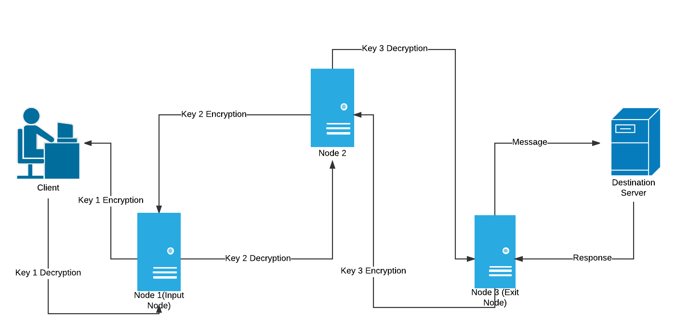

Slide 6
How does it provide anonymity
Imagine if there is a sniffer listening in at the first connection(client – input node) all it can know is the address of the input node and a thrice encrypted message that doesn’t make sense. So all the attacker/sniffer knows that you are browsing tor.
Similarly, if sniffing starts at the exit node all the sniffer sees is a server contacting another server but it can’t track the client or the source of the request generated.
But now you may think that if someone is listening in at Node 2 they will know the address of the input and exit and can trace the client and the destination server. But it’s not that simple, each of these nodes has hundreds of concurrent connections going on, and to know which one leads to the right source and destination is not that easy. In our circuit, Node 2 is a middle node but it can be a part of another circuit on a different connection where it acts as the input node receiving requests or an exit node serving up webpages from various servers.

Slide 7
Vulnerability in Onion Routing
The only security flaw in onion routing is that if someone is listening in on a server at the same time and matches the request at the destination to a request made by a client on the other side of a network by analyzing the length and the frequency of the characters found in the intercepted request or response at the destination server and using that to match with the same request made by a client a fraction of a second (time-stamps on requests and responses can also be helpful in deducing that) and then tracking them down and knowing their online activity and shattering the idea of anonymity.
This is pretty hard to do but not impossible. But removing this flaw from Tor is virtually impossible.

Slide 8
Advantages
Enhanced Security: Onion routing provides enhanced security by encrypting data multiple times and routing it through several servers, making it difficult for attackers to intercept or tamper with the communication.
Anonymity: Onion routing provides anonymity by masking the IP address of the sender and the receiver, making it difficult for anyone to identify them.
Resistance to Traffic Analysis: Onion routing makes it difficult for attackers to analyze the traffic patterns and identify the source and destination of the communication, thereby enhancing privacy and security.
Cross-Platform Compatibility: Onion routing is compatible with multiple operating systems and devices, making it accessible to a wide range of users.

Slide 9
Disadvantages
Slow Performance: Onion routing can result in slow performance due to the multiple layers of encryption and the need to route data through several servers.
Limited Accessibility: Onion routing is not widely accessible, and users may need specialized software to use it.
Malicious Use: Onion routing can be used for malicious purposes, such as to facilitate illegal activities, making it a target for law enforcement agencies.

Slide 10
Conclusion
Tor(The onion routing) provide as enhance security and anonymity from attackers/sniffing.
But, it is slow and limited accessibility and it can be use for malicious uses.
Tor transfers data through a minimum of three nodes. The sequence of the node is random

Slide 11
THANK YOU

